Slide 1
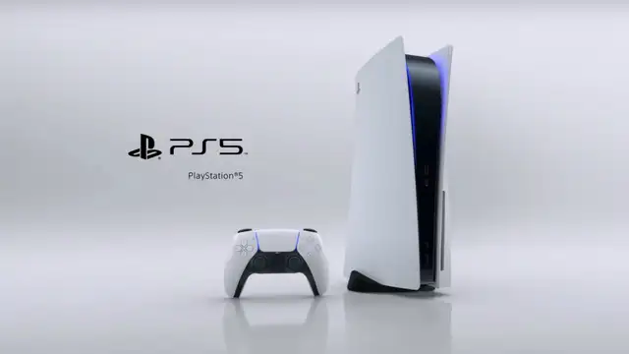
Team 4
Sony Interactive Entertainment (SIE)

Slide 2


How do we understand the factors that affect our profitability?
Methodology - with Descriptive Statistics & Predictive Modelling
The analysis was conducted using correlation and regression analysis, a statistical technique that examines the relationship between one or more independent variables and a dependent variable.
Internal Variables:
Total Revenue (Net Sales) of Sony
Operating Expenses of Sony
Unit Sales of PS5
R&D Expenses
External Variables:
Global Market Revenue -
Global Revenue Growth of the Market -
Global Average Revenue Per Capita -
Unit Sales of PS5 -
Product price can affect profitability surely but we couldn’t add price as a variable because PS5 prices are the same as during launch time.

Slide 3
Correlation
 | Total Revenue of Sony ($) | Game & Network Services Revenue (mio $)
Total Revenue of Sony ($) | 1
Game & Network Services Revenue (mio $) | 0.746413018 | 1
Is there a Correlation Between Total Revenue of Sony Game&Network Services Revenue?
After analyzing the correlation between Sony’s total revenue and the Game & Network Services industry revenue we found a strong positive correlation between both variables.
 | Game & Network Services Revenue (mio $) | R&D Expense (billion $)
Game & Network Services Revenue (mio $) | 1
R&D Expense (billion $) | 0.78956524 | 1
Is there a Correlation Between R&D Expense of Sony and Net Sales of Sony?
A strong positive correlation was also found between the R&D expense and the Game & Network Services Net sales of Sony.

Slide 4
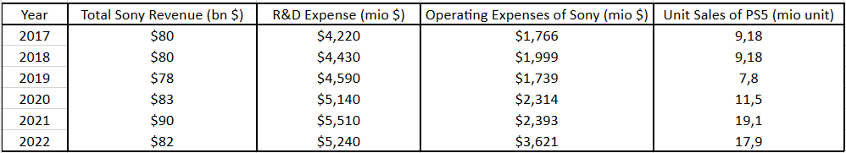
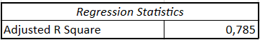
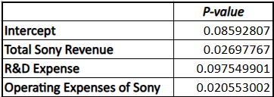
Regression Analysis for Internal Variables
which might affect profitability
Discussion
The results suggest that Total Sony Revenue and Operating Expenses of Sony are statistically significant predictors of Sony's profitability. Specifically, an increase in Total Sony Revenue is associated with an increase in profitability, while an increase in Operating Expenses of Sony is associated with a decrease in profitability.
However, the p-values for R&D Expense and the Intercept are not statistically significant, indicating that these variables are not significant predictors of Sony's profitability.
As a result, We can increase profitability by offering more innovative products, R&D costs are not a major factor in reducing our profits.
The Adjusted R-squared corrects for this by penalizing the addition of unnecessary variables.
A low p-value (typically less than 0.05) indicates that the relationship between the independent and dependent variables is statistically significant.

Slide 5
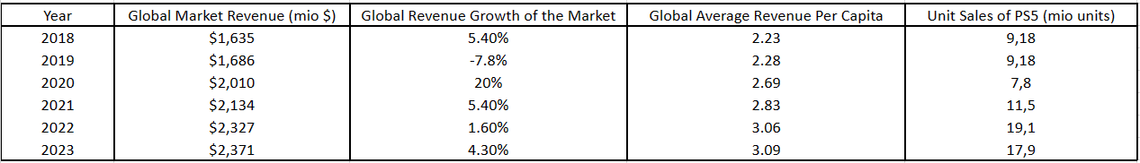
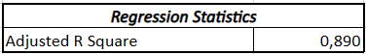
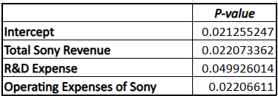
Regression Analysis for External Variables
which might affect profitability
Discussion
The results suggest that Global Market Revenue, Global Revenue Growth of the Market, and Global Average Revenue Per Capita are statistically significant predictors of Sony's profitability.
Specifically, an increase in these external factors is associated with an increase in Sony's profitability. The p-values for these variables are all less than 0.05, indicating that the relationships between these variables and Sony's profitability are statistically significant.
The Adjusted R-squared corrects for this by penalizing the addition of unnecessary variables.
A low p-value (typically less than 0.05) indicates that the relationship between the independent and dependent variables is statistically significant.

Slide 6



Recommendations
Remain Competitive, Increase Eco-Friendliness and efficiency
Promote PS+ Subscription

Slide 7

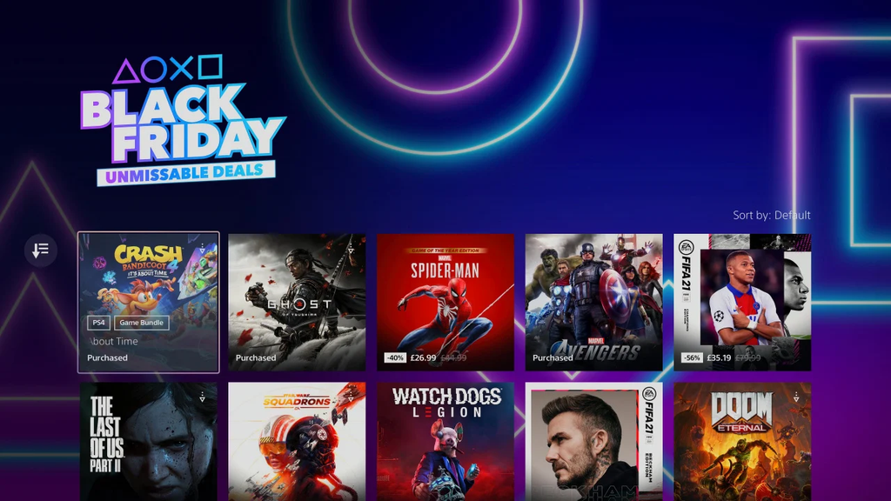
Recommendations
1st Party Development to push sales through compelling software
Adaptive Sales Strategies to consumer behavior and market trends

Slide 8
References
1) Sony Announces PS5 Sales Numbers, Says Putting MLB On Xbox Was A Good Move. (2023). GameSpot.
https://www.gamespot.com/articles/sony-announces-ps5-sales-numbers-says-putting-mlb-on-xbox-was-a-good-move/1100-6494758/
2) D’Angelo, W. (2023, October 1). PS5 vs Xbox Series X|S vs Switch Launch Sales Comparison Through Month 34. VGChartz. https://www.vgchartz.com/article/458530/ps5-vs-xbox-series-xs-vs-switch-launch-sales-comparison-through-month-34/
3) Shibboleth Authentication Request. (2023)
https://www-statista-com.hult.idm.oclc.org/statistics/1124784/unit-sales-ps5-worldwide/
4) Shibboleth Authentication Request. (2023)
https://www-statista-com.hult.idm.oclc.org/statistics/272639/number-of-registered-accounts-of-playstation-network/
5)Statista, and Sony. “PlayStation, Sony.” Statista, Dec. 2023.

Slide 9
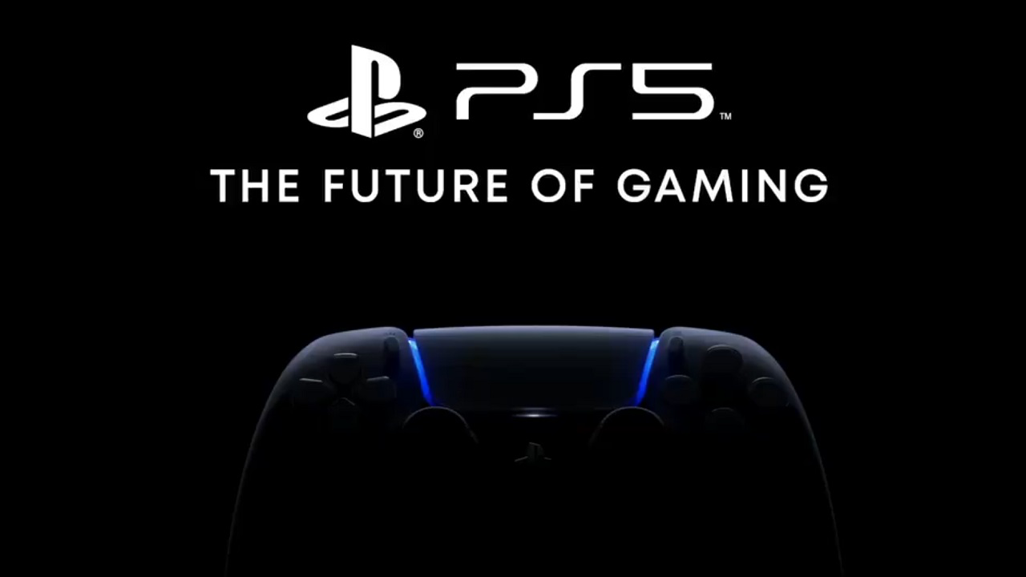
Let us write gaming history together!

